Slide 1
GetGainz
Noya Hafiz, Cherishma Jalaparti, Nick Brodsky, Carlos Avila

Slide 2
Business Background
The Problem
Fitness Tracking Challenges:
Users may lack a centralized platforms to log, monitor, and manage fitness progress
Manual tracking is time-consuming and can lead to inconsistent results.
The Solution
GetGainz: The Fitness Tracker App:
Centralized Fitness Management
Enables users to log workout, view workouts in a calendar format
Allows users to upload photo progress

Slide 3
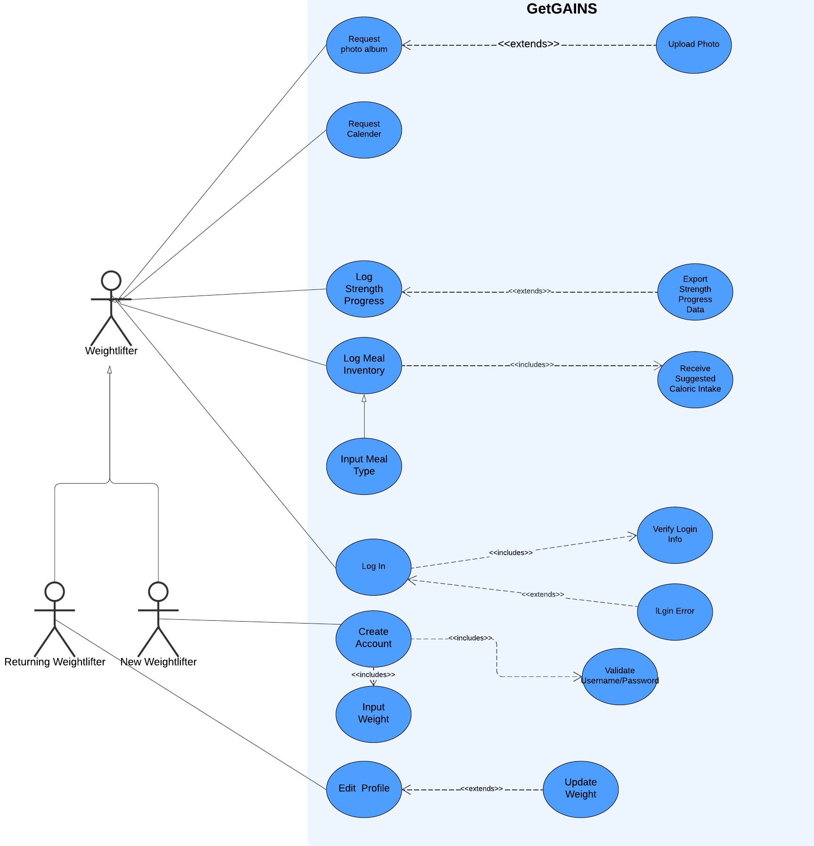
Use Case Diagram

Slide 4
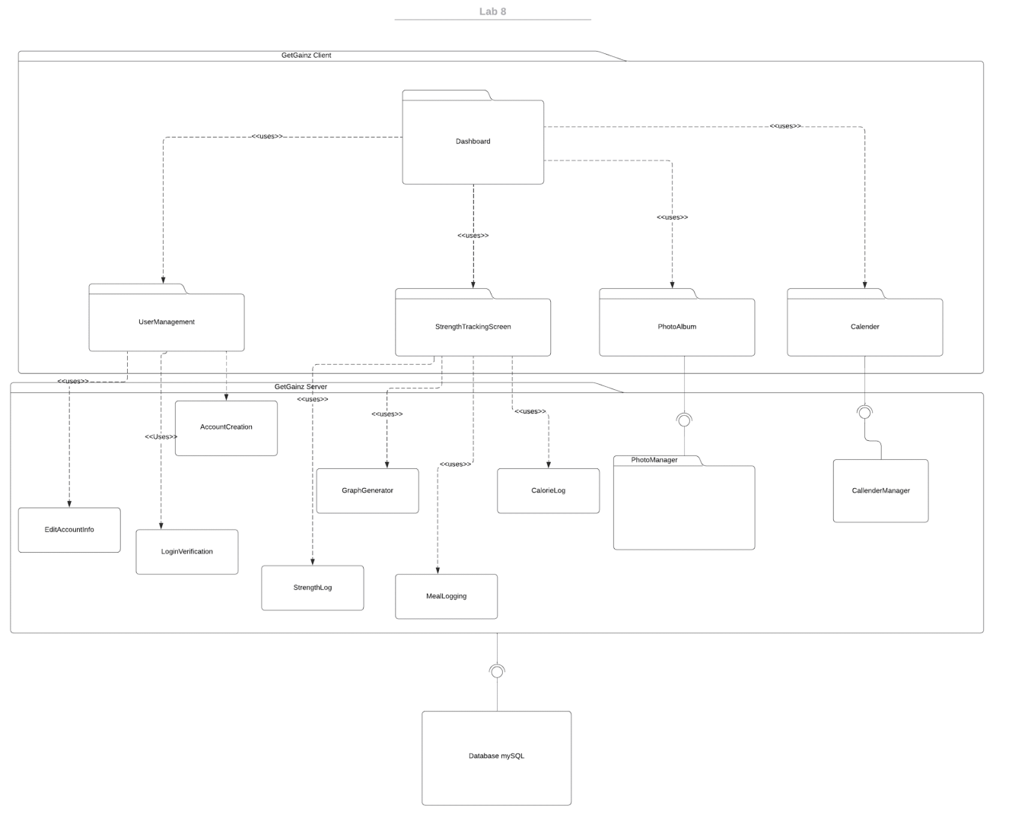
Architectural Design: Client-Server
H2 Database

Slide 5
Class Diagrams

Slide 6
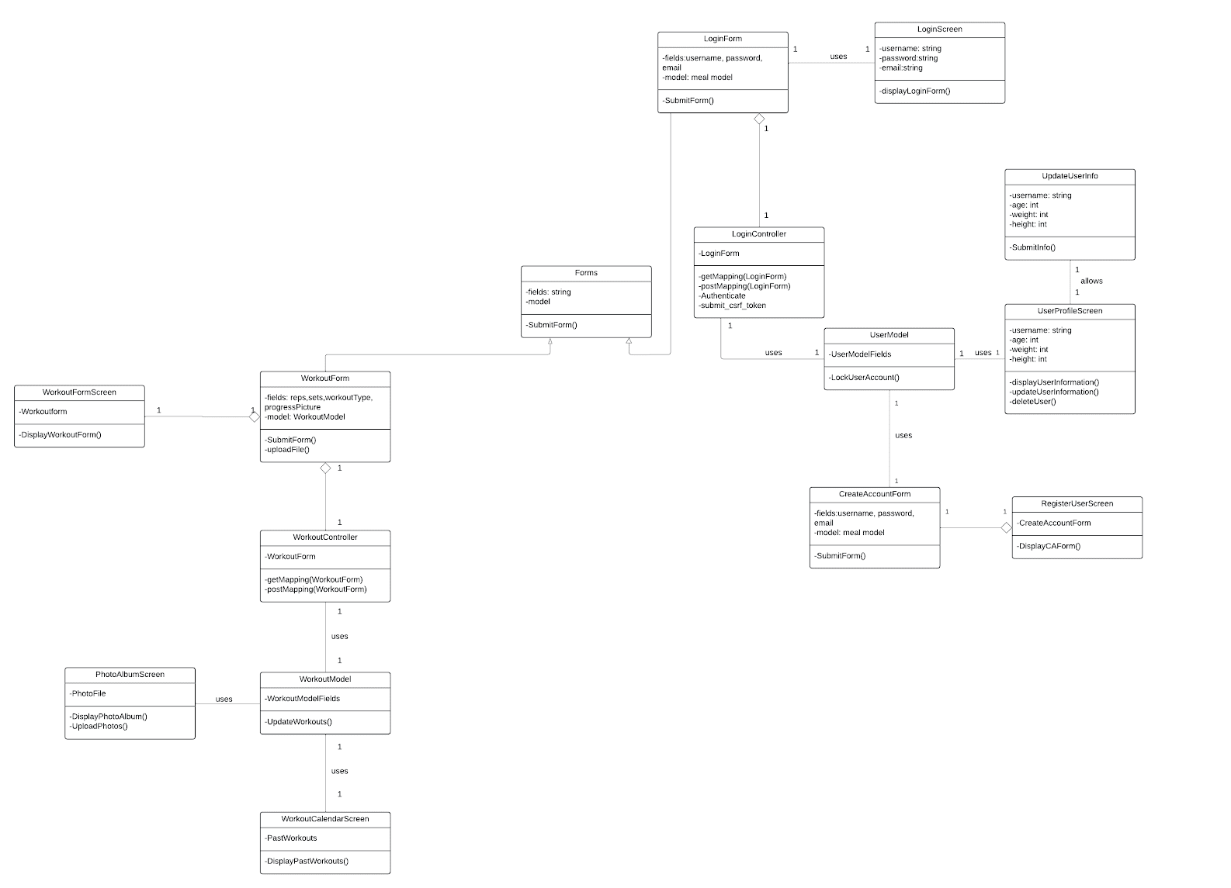
UML Class Diagram

Slide 7
Activity Diagrams

Slide 8
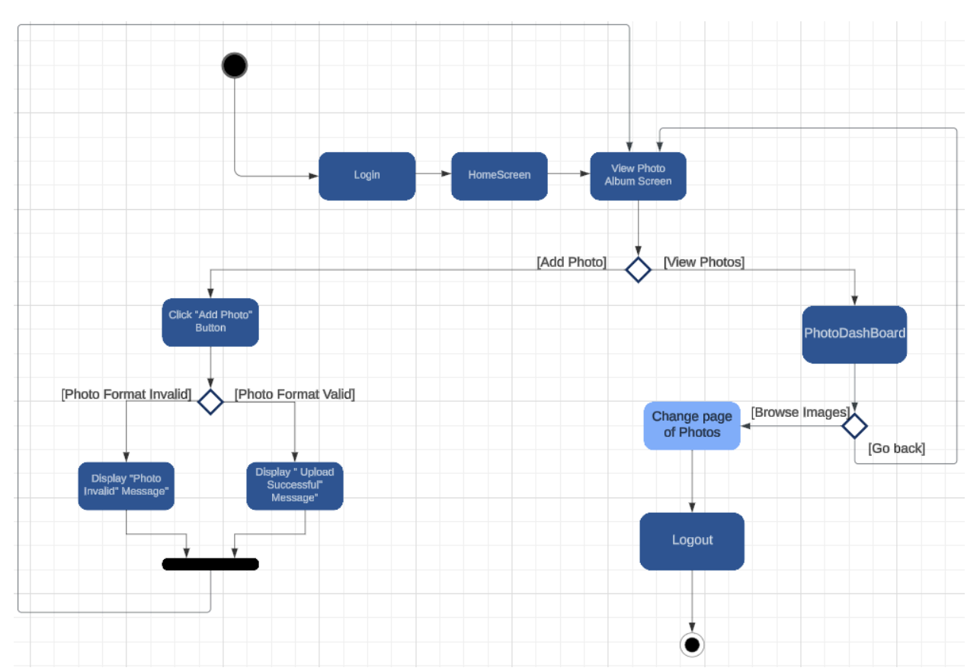
Photo Album

Slide 9
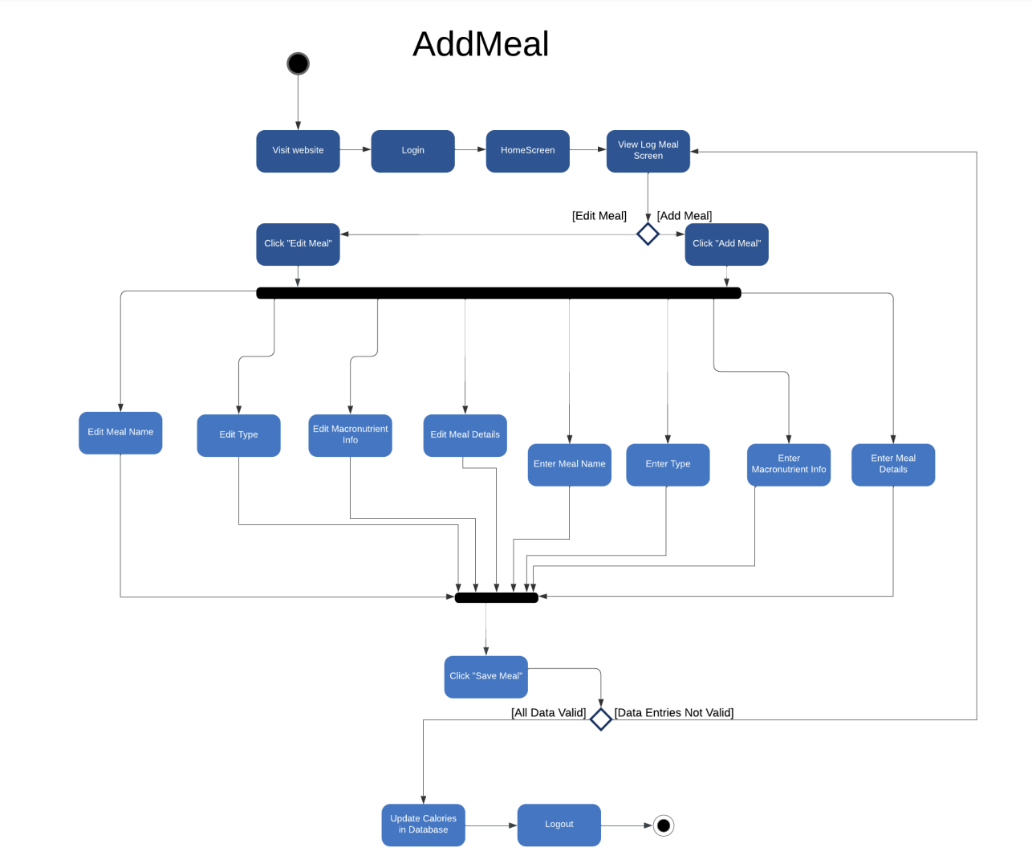
Add Meal

Slide 10
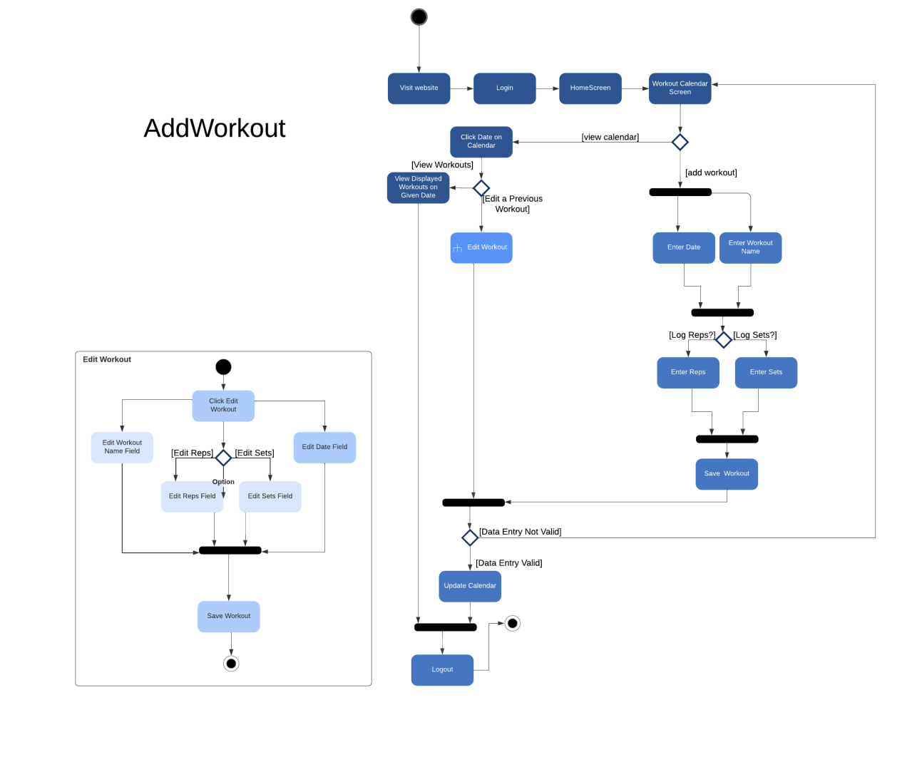
Add Workout

Slide 11
Sequence Diagrams

Slide 12
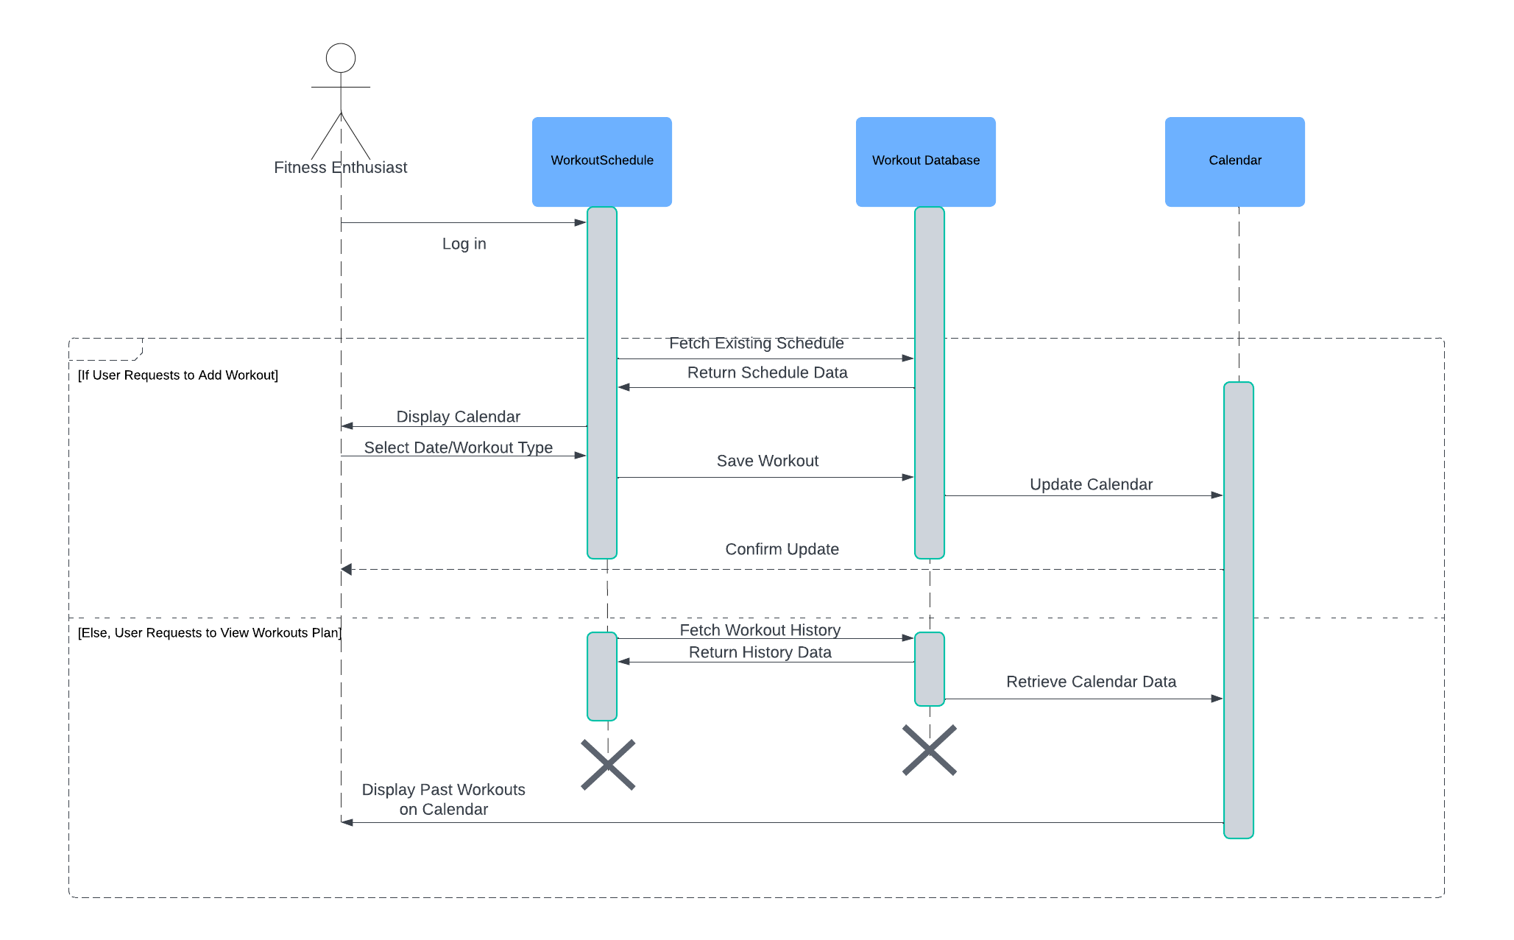
Calendar Sequence

Slide 13
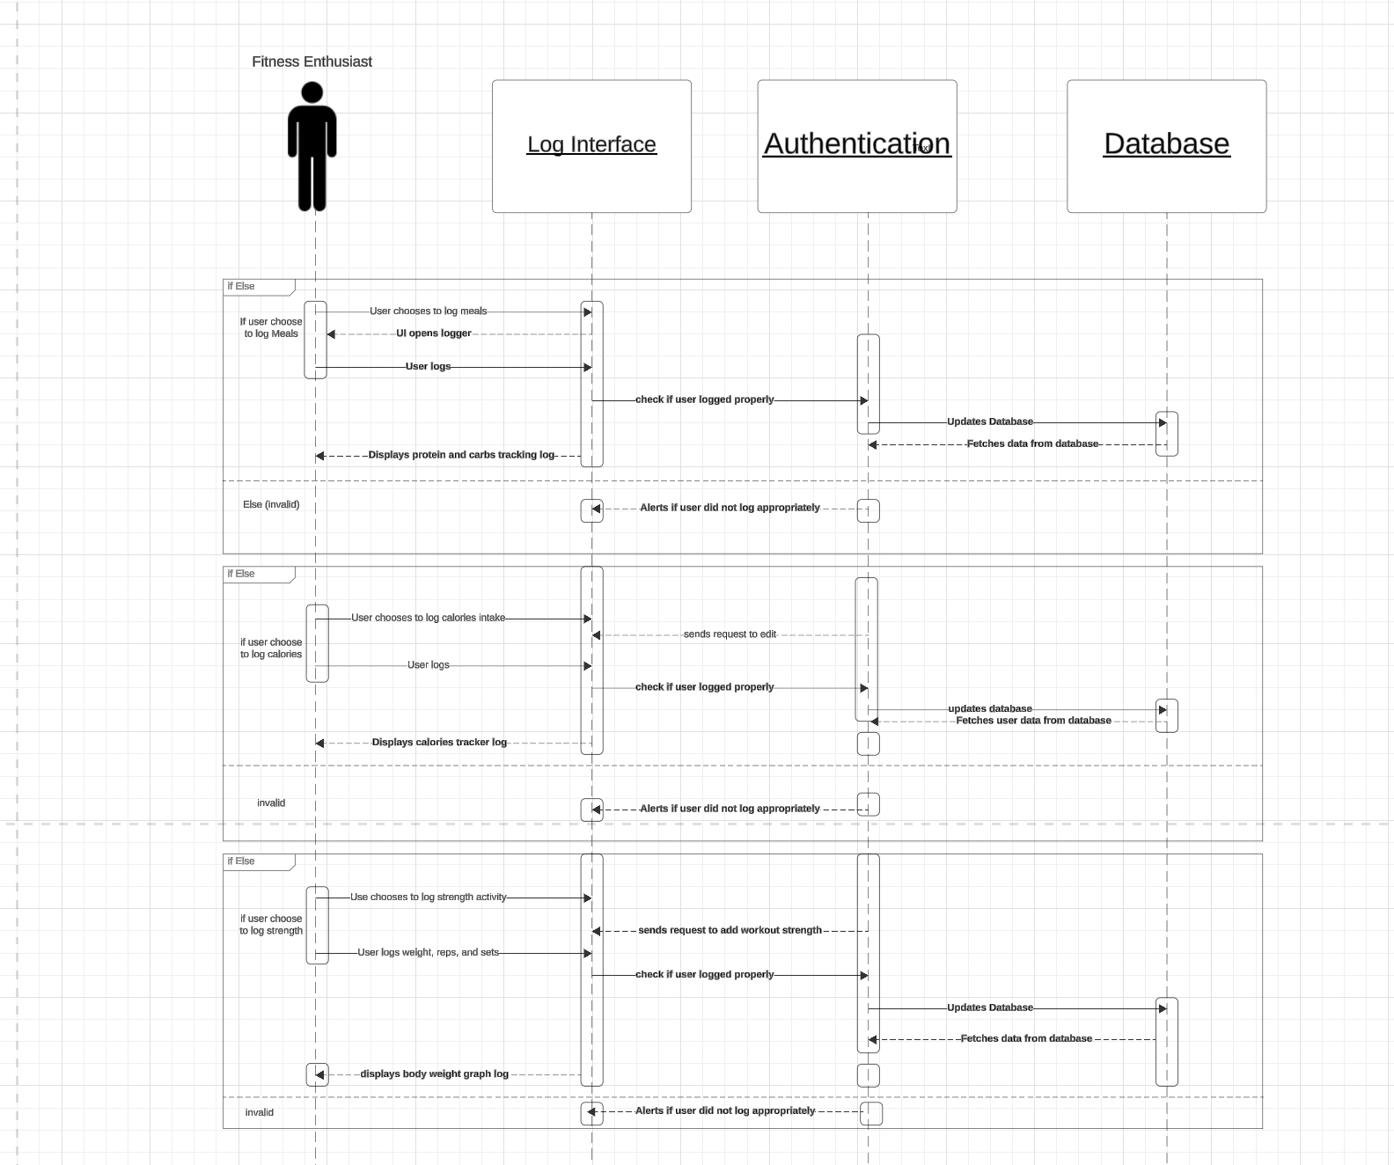
Log Meals, Calories, WorkOut

Slide 14
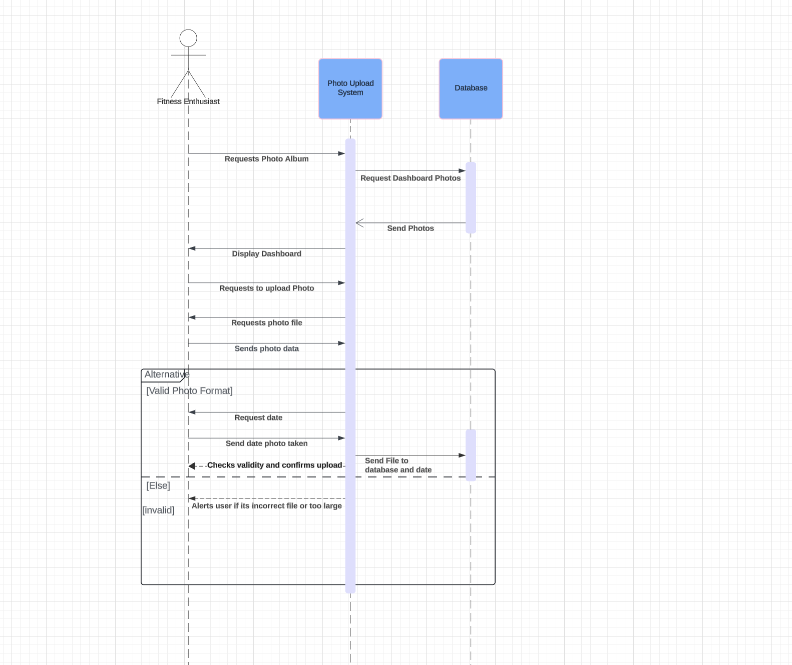
Photo Album

Slide 15
What We Learned
Lots of little problems that took time to resolve (learning Java, adjusting to IntelliJ)
Took more time then thought was needed
Start on writing code earlier
Java Spring was more of a headache than previously thought
Exploring IntelliJ Idea and database inside.

Slide 16
Future Improvements
Adding graph functionality, this includes tracking their calorie intake
A calendar module photo album that lets user to view their album through a calendar search
Delete Photo functionality
Meal Logging
Non local server

Slide 17
DEMO
https://drive.google.com/file/d/1p9y07LCOho5YEGjwStDNv3aWpWKJQzfI/view?usp=sharing

